Slide 1
Social Media Influence, Elections, and the Law
Notes:
FOCUS:
-laws/regulations about influence(social media, communications,2016 elections,digital tech, etc.)
-corruption, Congressional hearings about influence, due diligence of social media, influence
-exploitation of election power
-smart people about election influence
-private actors and policies
-privacy terms and conditions

Slide 2
SOURCE FOR NEXT CONTENT
ARTICLE: THE NEW FIGHTING WORDS?: HOW U.S. LAW HAMPERS THE FIGHT AGAINST INFORMATION WARFARE, 22 U. Pa. J. Const. L. 81
Source: University of Pennsylvania Journal of Constitutional Law
Author: Jill I. Goldenziel(Associate Professor of International Law and International Relations, Marine Corps University-Command and Staff College; Affiliated Scholar, Fox Leadership International, University of Pennsylvania) and Manal Cheema(J.D. Candidate, University of Virginia School of Law, 2020)
Date: November 2019
Approximate length: 82014 words

Slide 3
ARTICLE: THE NEW FIGHTING WORDS?: HOW U.S. LAW HAMPERS THE FIGHT AGAINST INFORMATION WARFARE, 22 U. Pa. J. Const. L. 81
One reason for this election influence and corruption is that U.S. laws and jurisprudence protecting free speech and privacy were not designed for the technological realities of today.
In 2016, the State Department ("DOS") proposed to identify social media influencers who were spreading Kremlin messages and target them with counter-arguments. However, the Privacy Act of 1974 restricts data collection related to the ways Americans exercise their First Amendment rights. State Department lawyers quashed the program, reasoning that tweets, retweets, and comments implicate the collection of data related to the ways Americans exercise their First Amendment rights. The State Department lawyers thus reasoned that the First Amendment prohibited a program that would have encouraged the First Amendment right to free political debate by adding political speech to the marketplace of ideas.
Information warfare weaponizes the first amendment
Russian information warfare adopts a guerrilla or "firehose of falsehood" approach, called the Gerasimov Doctrine.
Three distinctive features characterize the model: (1) engaging in a high number of platforms, (2) producing rapid, continuous, repetitive floods of messaging, and (3) disseminating partial truths or outright lies, whether or not they are consistent with one another. Russia's disinformation campaign functions by trying thousands of tactics until one succeeds.
The FBI, CIA, and NSA commissioned the Intelligence Community Assessment ("ICA"), a 2017 report to assess Russian activities and intentions in the 2016 election
According to a report commissioned by the Senate Intelligence Committee, the IRA's operations from 2013 to 2018 reached 126 million Facebook users, 20 million Instagram users, and 1.4 million Twitter users. The IRA uploaded one thousand videos on YouTube as well. Between 2015 and 2017, over 30 million users shared Facebook and Instagram posts generated by the IRA.
Notes:
Domestic election interference

Slide 4
The Agency's[IRA] messaging was not always "objectively false," and although it may have been offensive, most of it did not qualify as "hate speech."
US law ties US hands
The First Amendment gives the highest protection to political speech, which, under Supreme Court precedent, applies to many Russian disinformation efforts.
The Supreme Court's doctrine on incitement, one of the few areas of speech that is not protected by the First Amendment, likely does not extend to Russian disinformation campaigns in its current form.
Reno v. American Civil Liberties Union(1997): the Court established that online speech does not receive a lesser degree of First Amendment protection than other speech
Communications Decency Act of 1996 ("CDA"): the first notable attempt by the United States Congress to regulate pornographic material on the Internet. In 1997, in the landmark case of Reno v. ACLU, the United States Supreme Court struck the anti-indecency provisions of the act.
Packingham v. North Carolina(2017): the Court struck down a North Carolina statute that prohibited sex offenders from accessing social media sites. Social media is essentially a space for free expression.
Whitney v. California(1927): the solution to false speech is to counter it with more speech. True and false speech will compete in the marketplace of ideas until the truth prevails.
United States v. Alvarez(2012): First Amendment cases require the strictest scrutiny, regardless of whether the content of speech is true or false. Few categories of speech, such as obscenity, incitement to imminent lawless action, defamation, fighting words, speech integral to criminal conduct, true threats, and child pornography, are exempt from this ban on content-based regulation. Even then, false speech may be constitutionally protected, as in defamation cases.
Under First Amendment jurisprudence, government restrictions on foreign speech, even speech that promotes falsehoods, are likely unconstitutional

Slide 5
Trump’s 2018 Executive Order on Imposing Certain Sanctions in the Event of Foreign Interference in a United States Election: Allows the intelligence community ("IC") to respond after election interference occurs, but not before. The Order provides that the Director of National Intelligence ("DNI") has forty-five days after the conclusion of a federal election to determine whether a foreign government or agent has "acted with the intent or purpose of interfering in that election."
Under current law, the U.S. Government might not have the legal authority to shut down, block, or mask First Amendment-protected speech by a U.S. person absent a clear showing that the U.S. person is operating as an unregistered agent of a foreign power.
Restrictions narrowly tailored to prohibit threats to the electoral process by foreign individuals are especially likely to pass constitutional muster and should be done so[Restrict Speech by Foreign Individuals in the Electoral Context]
Congress should also pass a narrowly tailored law that would prohibit false speech that is designed to attack the integrity of the electoral process[Restrict False Speech Designed to Skew Elections]

Slide 6
Any effective legislation that would protect the U.S. electoral process from foreign interference must be able to prohibit certain speech or conduct by agents of foreign adversaries. Yet, determining who qualifies as an agent of a foreign state is complicated, and determining who qualifies as an agent of a non-state actor is even harder. Any legislation created to address disinformation campaigns would be incomplete without specifying what link between principal and agent is required to restrict certain free speech rights.
The government can also regulate paid social media advertisements by foreign actors designed to influence the electoral process, just as it does on traditional media sites. For example, the government can require that any paid political advertisements include a clear statement of who paid for or is disseminating a message.
Washington Post v. McManus(2019): A federal district court struck down Maryland's Online Electioneering Transparency and Accountability Act ("OETA") on First Amendment grounds. The OETA was enacted to help combat events like the 2016 Russian disinformation campaign. The Act required social media and news sites to self-publish an ad-buyer's identity and the total amount paid. The platform must post this information in a searchable format within forty-eight hours of the purchase, place it in a "clearly identifiable location" on the platform's website, and keep it there for at least one year following the relevant general election. McManus is the only federal decision on legislation to regulate paid political advertisements in the wake of the Russian electoral threat. The court asserted that Maryland had compelling interests in preventing foreign governments and their nationals from interfering in their elections, informing voters about the source of online advertisements, and deterring corruption. However, the statute was both over- and under-inclusive because it regulated more speech than is necessary and did not regulate the main tools that foreign operatives used to disrupt the 2016 elections.

Slide 7
Legislation to regulate bots can also help fight information warfare. Congress might consider laws making it illegal for bots to deceive people about their identity for the purposes of influencing elections. California is leading the way in this area, passing a law in September of 2018 that essentially makes it illegal for a person to use a bot.
The United States can also combat Russian information warfare by investigating and prosecuting operatives who seek to infringe upon U.S. citizens' right to vote. Congress can enact legislation criminalizing information campaigns that are designed to suppress the vote. To ensure protection for freedom of speech, Congress must carefully define a standard for distinguishing information campaigns designed to suppress the vote from other political speech.
Any attempts to regulate online platforms and social media will raise First Amendment concerns, despite their status as private entities
Requiring online platforms to be responsible for the content of their users' postings might qualify as collateral censorship
Social media companies might be legally regulated as sellers of a customer service. Just like public accommodations can be regulated by the government to ensure that they do not violate the constitutional rights of those who are allowed inside, so too can social media. Just like the government can restrict who buys a gun, so too can the government restrict who is allowed on social media sites. And just like the government can police illegal activity in a private establishment, so too can it police illegal behavior on social media.
Some officials may push for online platforms to serve as "de facto Internet police" because it is less costly and more efficient than for the government to do so.
The Federal Government could pressure online platforms to control the speech of their users through a "good corporate citizen" program, which requests online platforms to "voluntarily remove questionable content or alert government authorities to its existence."
Under the CDA, online platforms are immune from civil liability for any "Good Samaritan" blocking or screening of "objectionable" material.
Notes:
https://leginfo.legislature.ca.gov/faces/billTextClient.xhtml?bill_id=201720180SB1001

Slide 8
SOURCE FOR NEXT CONTENT
ARTICLE: What If More Speech Is No Longer the Solution? First Amendment Theory Meets Fake News and the Filter Bubble, 70 Fed. Comm. L.J. 55
Source: Federal Communications Law Journal
Author: Philip M. Napoli(James R. Shepley Professor of Public Policy, Sanford School of Public Policy, Duke University; Andrew Carnegie Fellow)
Date: April 2018
Approximate length: 22838 words

Slide 9
ARTICLE: What If More Speech Is No Longer the Solution? First Amendment Theory Meets Fake News and the Filter Bubble, 70 Fed. Comm. L.J. 55
"More speech" (i.e., counterspeech) becomes an effective and First Amendment-compliant approach to assuring that individuals have the information they need to be informed and effective participants in the democratic process.
There is the assumption that individuals are capable of discerning between true and false information.
A second assumption is that participants in the idea marketplace place greater value on true news and information than they do on false information.
As late U.S. Supreme Court Justice Antonin Scalia has stated, "given the premises of democracy, there is no such thing as too much speech.”
The well-known Fairness Doctrine[not really applicable today] is a useful case study of a rare instance in which the counterspeech doctrine has been utilized to justify government regulation. The Fairness Doctrine required broadcast licensees to devote news coverage to controversial issues of public importance.
Twitter has organized online convenings to facilitate discussions about strategies for producing and disseminating counterspeech through social media. Google, in its 2017 testimony before the Senate Subcommittee on Crime and Terrorism about its initiatives to combat extremist content and disinformation on its platforms, highlighted that it is "creating new programs to promote counterspeech on [its] platforms." These programs include efforts to redirect consumers of extremist propaganda toward content that counters those narratives, as well as efforts to encourage YouTube content creators to speak out against hate speech, xenophobia, and extremism.
The shift in the relative prominence of legitimate versus false news is a function of the fact that the gatekeeping barriers that have traditionally curtailed the dissemination of false news relative to legitimate news have been dramatically reduced[ Diminished Gatekeeping and Distribution Barriers]

Slide 10
The distribution of false news can now be more effectively targeted at those individuals most likely to be affected by the misinformation[Increased Ability to Target the Most Impressionable]
Technological changes are undermining news consumers' abilities to distinguish between legitimate and false news
Recent research by the Pew Research Center indicates that individuals who consume news via social media are capable of identifying the originating source of the story consumed only about half the time.
It seems necessary that, going forward, First Amendment jurisprudence and the operational decision-making of social media platforms, recognize the more limited efficacy of counterspeech within the context of the operation social media platforms. It seems appropriate that, within the context of news on social media, the counterspeech doctrine should receive the same kind of more circumspect and limited application that has been advocated for in speech contexts, such as hate speech and adopted by the courts in contexts such as libel.
These social media platforms should adopt a greater institutional commitment to a public interest-grounded approach to content filtering, in keeping with the editorial responsibilities that have characterized previous generations of news organizations.
The end result today at the end of the day is a state of market failure in the marketplace of ideas.

Slide 11
SOURCE FOR NEXT CONTENT
ARTICLE: RUSSIAN ELECTION INTERFERENCE AND RACE-BAITING, 9 Colum. J. Race & L. 191
Source: Columbia Journal of Race and Law
Author: Darin E.W. Johnson(Associate Professor of Law, Howard University School of Law; J.D., Harvard Law School; B.A., Yale College)
Date: 2019
Approximate length: 60209 words

Slide 12
ARTICLE: RUSSIAN ELECTION INTERFERENCE AND RACE-BAITING, 9 Colum. J. Race & L. 191
The intelligence agents had a thorough understanding of the important role that minority turnout would play in the election. By mid-2016, the IRA began an active campaign through social media to suppress minority voter turnout. For example, in the Instagram group "Woke Blacks," the IRA posted: "[A] particular hype and hatred for Trump is misleading the people and forcing Blacks to vote Killary. We cannot resort to the lesser of two devils. Then we'd surely be better off without voting AT ALL."
Racial division was fundamental to Russia's interference campaign. More than half of the Russian advertisements on Facebook, for example, used race as a central theme to sow disunion
Facebook was particularly vulnerable to a strategic advertisement operation because its self-service advertisement model permits users to create their own advertisements and target recipients based on geography, demographics, and specific interests. There is a very large challenge in regulating any of this since Facebook advertisements are economically and legally sound overall.
The Russian cyber disinformation scheme was much more prominent on Instagram than had previously been reported. The IRA began to shift its activity to Instagram in 2017 after the media began reporting on their Facebook and Twitter operations.
Although the Constitution drafters expressed significant concern about foreign influence in domestic elections, no explicit prohibition addressing such foreign influence appears in the Constitution.
Foreign espionage has not been expressly addressed under international law. Espionage has historically been a violation of domestic, but not international, law.
Reducing institutionalized racism will reduce racial tensions, which will in turn reduce Russia's ability to stimulate divisions.

Slide 13
SOURCE FOR NEXT CONTENT
Democracy Under The Influence: Paradigms of State Responsibility for Cyber Influence Operations on Elections
Source: Chinese Journal of International Law (UK)
Author: Barrie Sander(Postdoctoral Fellow, Fundao Getulio Vargas (FGV), School of International Relations
Date: August 15th, 2019
Approximate length: 50409 words

Slide 14
Democracy Under The Influence: Paradigms of State Responsibility for Cyber Influence Operations on Elections
Cyberspace is an enabling environment that allows actors to transmit information to large audiences at low cost, near instantaneously, through multiple distribution points, across borders and with heightened opportunities for anonymity. In addition, the increasing quantity of personal information stored online, as well as the trail of "digital breadcrumbs" that are deposited unwittingly as a result of an individual’s online and offline activities, constitute a treasure trove of data that can be exploited for the purposes of launching influence operations.
In the electoral context, foreign actors have deployed two types of cyber influence operations for the purpose of meddling in the electoral processes of other States: first, the hacking and leaking of non-public information into the public domain for the purpose of harming an individual, organisation, or State-a practice known as "doxing"; and second, the deliberate use of newly-created or publicly available information to threaten, confuse, or mislead a target audience-a practice referred to here under the label of "information operations".
Most prominently, two strategic hacks occurred during the 2016 US presidential election. The first occurred allegedly when the Russian General Staff Main Intelligence Directorate (GRU) gained unauthorized access to the networks of the Democratic National Committee (DNC) between July 2015 and June 2016, exfiltrated large volumes of data including emails that indicated the preferences of various Democratic Party officials for Hillary Clinton over Bernie Sanders, and subsequently published the emails in two waves strategically timed to cause significant disruption to the political process. The second entailed the intrusion of the email account of John Podesta-the chairman of Hillary Clinton’s presidential campaign-the exfiltration of his emails, and their subsequent publication a mere hour after the Washington Post had released the Access Hollywood tape of Donald Trump making degrading remarks about women.
It is not uncommon for mal-information and disinformation operations to be conducted in tandem as part of a coordinated information campaign-whether to influence how citizens vote or to undermine confidence in the integrity of a vote.

Slide 15
A cyber influence operation may amount to a violation of the target State’s sovereignty under international law, but is very challenging and unclear.
A cyber influence operation targeting an election may amount to a violation of the duty of non-intervention in the internal or external affairs of another State.
A cyber influence operation on a State’s electoral process may constitute a breach of the duty of due diligence.
Beyond technical and political attribution, a State targeted by a cyber operation must identify a sufficient legal nexus between a breach of international law and a State in order for the breach to qualify as an internationally wrongful act.
A cyber influence operation on an election may amount to a violation of the right to political participation.
A cyber influence operation on an election may amount to a violation of the right to freedom of expression.
A cyber influence operation on an election may violate the collective right of a people to self-determination.
Beyond the rights to political participation and freedom of expression, a further possibility is that doxing operations may violate the right to privacy of the individuals whose non-public information is exfiltrated and leaked into the public domain. The right to privacy is set out in a range of international human rights treaties and also recognised under customary international law.
The principal challenge to concluding that cyber influence operations on elections violate international human rights obligations, however, is the contested scope of the extraterritorial application of this body of law.

Slide 16
SOURCE FOR NEXT CONTENT
ARTICLE: FOOL ME ONCE: REGULATING "FAKE NEWS" AND OTHER ONLINE ADVERTISING, 91 S. Cal. L. Rev. 1223
Source: Southern California Law Review
Author: Abby K. Wood(Associate Professor of Law, Political Science, and Public Policy at University of Southern California) and Ann M. Ravel(Senior Fellow, Maplight Digital Deception Project and former Chair of the Federal Election Commission and California Fair Political Practices Commission)
Date: September 2018
Approximate length: 54972 words

Slide 17
ARTICLE: FOOL ME ONCE: REGULATING "FAKE NEWS" AND OTHER ONLINE ADVERTISING, 91 S. Cal. L. Rev. 1223
Internet platforms prefer self-regulation and have only recently come around to supporting proposed transparency legislation. There currently are not many regulations for social media and internet platforms. While government must not regulate the content of political speech, it can, and should, force transparency into the process.
Our campaign finance laws are riddled with gaps and loopholes, which exclude a large portion of online advertising from disclosure and disclaimer requirements.
The government should not rely upon the platforms to regulate themselves. While each platform is making proposals to increase transparency for online political advertising, the lack of transparency originated with the platforms, and for at least a decade, it appeared to serve their profit interests.
Fake news is political advertising and costs money in terms of production and distribution. This can potentially trigger some regulations.
The FEC lacks a coherent regulatory approach to implementing the Federal Election Campaign Act's press (or "media") exemption from campaign finance regulation.
Bluman v. FEC(2012): The Supreme Court voiced strong views that the government has a compelling interest in limiting direct campaign contributions by foreign nationals, though the language is somewhat uncertain about other involvement of foreign nationals.
Under the existing jurisprudential framework, government's main involvement to combat disinformation advertising will be related to transparency
Government is constitutionally prohibited from anything resembling censorship, and moreover, the platforms are in a better position to experiment with interventions that address the disinformation problem head-on
A paid ad distributed via social media (on the Internet) must carry disclaimers like any other public communication if it advocates for the election or defeat of a clearly identified candidate. However, anything posted for free, like a blog post, a Tweet, or even disinformation that one generates personally from their personal profile or page, requires no disclaimer, even if it mentions a candidate by name right before the election, and even if it is amplified by a paid "bot army" or purchased "shares" on Facebook.
Disclosure rules are also fraught with holes and exceptions that have led to untraceable money pumping through our elections.

Slide 18
In order to subject online political advertising to disclaimer and disclosure requirements, the groups producing large amounts of it should be required to register with election administrators, just as they do when making political expenditures offline.
Government should require political advertisers on large social media platforms to save and post every version of every political communication placed online, whether video, print, or image, and whether placed "for a fee" or not. The communications should be placed on a dedicated and easy-to-locate page on the campaign's or group's website or user page on the platform, as well as on a dedicated page created by the platform.
Reviewing ads for mentions of candidates and political issues is not difficult, particularly with human involvement.
Subjecting political advertisers to a source check can be done by Facebook with little difficulty. In the interest of national security, government should require that the platforms report when an ad is obviously funded by a foreign source, in real time, or as soon as the platform becomes aware of it.
To enforce disclaimer requirements, platforms can deputize users to report disclaimer violations, in the same way that the platforms allow users to report violations of the terms of service.
Donor anonymity for LLCs and 501(c) organizations should be eliminated
A simple education campaign on platforms can inoculate users, helping them learn how to avoid spreading disinformation.
Three general considerations will help any private regulatory framework to be effective. First, any efforts to label and identify questionable (or trustworthy) stories or sources should be consistent across platforms. Second, the platforms should aim at incentives. They can do so in overt ways, such as Facebook's plan to temporarily ban advertisers who repeatedly share disinformation advertising that has been marked by fact checkers as "false news." Third, the platforms can turn down the volume of disinformation advertising by enforcing their terms of service, which prohibit bots and "inauthentic likes."
New York's Democracy Protection Act(2018): requires disclosure of all online ads, advertiser verification and registration with the NY Board of Elections, and an online archive.
Whether government can constitutionally require platforms to inoculate users or provide opt-in and opt-out regimes are both open questions under the First Amendment.

Slide 19
SOURCE FOR NEXT CONTENT
CHILDRESS LECTURE: WAS THE 2016 ELECTION LEGITIMATE?, 64 St. Louis L.J. 635
Source: Saint Louis University Law Journal
Author: Chad Flanders
Date: Summer 2020
Approximate length: 18397 words

Slide 20
CHILDRESS LECTURE: WAS THE 2016 ELECTION LEGITIMATE?, 64 St. Louis L.J. 635
An election's legitimacy can be questioned if the tabulation of the votes - either in the casting of the votes or in the counting - is altered so dramatically that the wrong person wins.
If there is doubt about the rightness of the election result, this could also mean that the election was not legitimate.
Irregularities are bad enough for elections to be illegitimate when they lead to a widespread, reasonable belief that there is a good chance that, but for the irregularities, the election would come out differently
The hardest case at issue is not whether Russia hacked the election or whether Clinton, because she won the popular vote, should have been declared the victor. The hardest case is one in which there was no Russian effort to directly manipulate the election results and where the election rules were in fact followed, but where there was a widespread effort to change people's minds about the candidates in the election.
If the messages sent by the Russians via Facebook and Twitter were instead put up by supporters of Donald Trump or by Trump himself, then there would presumably be no problem - or at least not any problem above and beyond the problem that heated rhetoric and sloganeering usually present.
A commonly proposed remedy to the problem of wealthy corporations and billionaires - or people who would make emotional appeals or scurrilous attacks - is not necessarily to stop them from spending money to influence elections but to require that they be transparent about it.

Slide 21
SOURCE FOR NEXT CONTENT
ARTICLE: Disinformation Operations Aimed at (Democratic) Elections in the Context of Public International Law: The Conduct of the Internet Research Agency During the 2016 US Presidential Election, 47 Int'l J. Legal Info. 149
Source: International Journal of Legal Information
Author: Manuel Rodriguez(a jurist in the Private Security Services Section within the Division for Security Policy at the Swiss Federal Department of Foreign Affairs (FDFA)
Date: Winter 2019
Approximate length: 84626 words

Slide 22
ARTICLE: Disinformation Operations Aimed at (Democratic) Elections in the Context of Public International Law: The Conduct of the Internet Research Agency During the 2016 US Presidential Election, 47 Int'l J. Legal Info. 149
The Internet Research Agency LLC is a Russian legal entity engaged in political and electoral interference operations. During the 2016 presidential election, Russia used the Agency, which is located in St. Petersburg, to amplify the dissemination of false information and news coverage on the presidential election.
Twitter for instance found more than 3,000 accounts connected to the IRA.
The IRA procured and used computer infrastructure, partly based in the US, to hide the Russian origin of its activities. The Agency bought space on computer servers located inside the US to set up Virtual Private Networks (VPNs). The Agency also owned hundreds of web-based email accounts hosted by US email providers under false names in order to appear as US personas.
Currently there is no rule in international law explicitly prohibiting disinformation operations aimed at (democratic) elections. The absence of an explicit prohibition is significant because as a general principle, that which international law does not prohibit it permits.
Matters on which international law does not speak or that international law leaves to the prerogative of States are considered domaine réservé and therefore protected from intervention by other States.

Slide 23
As coercion can be said to subordinate the will of the target State, in the case of an election, this may be manifested in the election of a candidate who otherwise would not win.
It is difficult to first find that the IRA's disinformation operations violated an international obligation, and second to attribute the conduct to the Russian State.
Necessity refers to circumstances in which a State's "essential interests" face "grave and imminent peril" and the only way of safeguarding the interests is temporarily not to comply with its international obligation of lesser weight or urgency.
Stretching current international legal norms to cover the issue does not seem to be the optimal solution and a binding international treaty would also need to overcome various hurdles.
Once the State knows or should have known that its territory is being used for a cyber and/or information operation that will affect the rights of another State, and also causes serious adverse consequences to it, the State must take all reasonably available measures to stop the operation (i.e. undertake so-called "best efforts").
The EU Code of Practice on Disinformation provides the only instrument, which specifically focuses on disinformation and could potentially provide a role model for the US to follow. The code is a self-regulatory instrument, where online platforms (e.g. Google, Facebook, Twitter, Mozilla) and the advertising industry, on a voluntary basis, commit to fight online disinformation with a broad variety of policies (applicable in States that are contracting parties to the European Economic Area)

Slide 24
SOURCE FOR NEXT CONTENT
ARTICLE: FARA ON FACEBOOK: MODERNIZING THE FOREIGN AGENTS REGISTRATION ACT TO ADDRESS PROPAGANDISTS ON SOCIAL MEDIA, 21 N.Y.U. J. Legis. & Pub. Pol'y 903
Source:New York University Journal of Legislation and Public Policy
Author: Joshua R. Fatta(An attorney-advisor in the Office of the General Counsel at the U.S. Department of Homeland Security)
Date: 2018/2019
Approximate length: 45081 words

Slide 25
ARTICLE: FARA ON FACEBOOK: MODERNIZING THE FOREIGN AGENTS REGISTRATION ACT TO ADDRESS PROPAGANDISTS ON SOCIAL MEDIA, 21 N.Y.U. J. Legis. & Pub. Pol'y 903
Russian social media disinformation actors during and after the 2016 election did not fulfill their obligation to register as agents of a foreign principal under the Foreign Agents Registration Act ("FARA"), the primary federal law concerning the political activities of foreign entities in the United States.
The attorney for one of the indicted Russian organizations said: "Never before has a foreign corporation ... with no presence in the United States, been charged criminally for ... the political speech of individuals on social media, at rallies, or in advertisements during a U.S. presidential election campaign."
In September 2017, DOJ asked T&R Productions LLC, the company that supplies broadcasting services to the U.S. affiliate of the state-owned Russian news outlet RT, formerly known as Russia Today, to register under FARA as a foreign agent.
A Washington, D.C., radio station named Reston Translator, which broadcasts Russian state-funded news outlet Sputnik, registered with DOJ as a foreign agent in November 2017 as well.
In March 2017, Senators Todd Young (R-IN) and Jeanne Shaheen (D-NH) introduced the Foreign Agents Registration Modernization and Enforcement Act, which would provide DOJ with the authority to investigate potential FARA violations and compel organizations to produce documentation to confirm funding sources and foreign connections.
While most of this allegedly Russian activity was coordinated from abroad, some was conducted within the United States. IRA affiliates traveled to the United States under false pretenses to collect intelligence to inform its operations. The IRA also used computer infrastructure inside the United States.
Applying FARA to foreign-based social media disinformation campaigns poses a number of statutory challenges.

Slide 26
First, FARA applies to an agent who "engages ... within the United States in political activities for or in the interests of [a] foreign principal" (emphasis added), but foreign social media propaganda agents are operating from abroad, not from "within" the United States. Second, FARA defines a foreign principal as any "person outside of the United States," referring to the traditional paradigm where a foreign country sends an agent inside the United States to influence its political process. This paradigm gives no guidance, however, as to how to distinguish social media agents operating from abroad from their foreign principals, who also operate from abroad. Third, the relationship between those operating behind the computer screen and the entities from which they may be taking direction is often more complicated and attenuated than the simple principal-agent relationship that FARA envisioned, requiring an analysis of the law of agency in the context of these social media actors.
When it comes to adapting FARA to disinformation actors on social media, distinguishing who is the agent and who is the foreign principal is less challenging than resolving a more fundamental issue: is it even possible to identify, with any degree of certainty, who these social media operatives are? Can a Facebook page or Twitter account be attributed to a specific foreign actor with high confidence?
Direct attribution occurs when an entity can be identified by tracking its IP address, payments, or some other form of evidence that directly links the actor to the act. Indirect attribution, carried out by research experts who do not have access to identifying information like IP addresses or payments, can be done by comparing social media identities across platforms and watching for common themes.
Twitter has echoed some of the claims in the indictment by disclosing that it identifies Russian-linked accounts by looking at whether the account was created in Russia, "whether the user registered the account with a Russian phone carrier or a Russian email address, whether the user's display name contains Cyrillic characters, ..., and whether the user has logged in from any Russian IP address."
Social media researchers generally suggest three As for spotting a fake account: "activity," "anonymity," and "amplification."
Researchers using machine learning claim to be ninety-five percent accurate, with most of the errors being false negatives, i.e., troll accounts that were missed, rather than false positives, i.e., real accounts incorrectly classified as trolls.
The most challenging issue when it comes to labeling social media accounts is determining which accounts to label. While social media companies and the U.S. government have identified the IRA as one specific actor in the Russian disinformation campaign, the identification of a specific organization with such certainty may not always be possible.

Slide 27
A scheme that involves labeling some accounts that may later prove innocent comes with potential legal challenges, such as arguments that the scheme is overbroad under the First Amendment, is a violation of the Due Process Clause of the Fourteenth Amendment, or entails labeling decisions that are arbitrary and capricious under the Administrative Procedure Act.
DOJ cannot compel social media companies to refuse to publish the materials of suspected agents of foreign principals because FARA does not involve censoring materials.
On Twitter, there is no requirement that an account reveals the operator's true identity, so operating a fake account is not in and of itself a violation subject to takedown.
While Facebook does ban coordinated inauthentic behavior completely, Facebook's official platform requires only the reduction, not removal, of false information, allowing some of these sources to remain online even if they have been identified as potentially fake. Facebook also has suggested that unless there is a pressing political real-world event that fake news on its site is attempting to influence, it may choose not to take down suspected fake accounts so quickly.
Requiring social media companies to label the informational materials of foreign operatives also raises a potential First Amendment challenge.
Facebook's attempt in 2018 to put red flags on fake news stories backfired when users began sharing the labeled hoaxes even more, and Facebook's introduction of a "tool that verifies ad-buyers' identities ... still allows ads from buyers with falsified identities to slip through." Twitter's efforts to combat tweets that most likely come from bad actors have often only pushed the tweets down into the "show more replies" section, rather than labeling the tweets as fake.
A strict enforcement regime could, theoretically, drive the business of emerging technology companies to other countries. As such, any regulatory regime in this space may ultimately be more effective if it is undertaken in coordination with foreign countries and partners, establishing uniform standards and requirements.
To a significant degree, the problem of fake news on social media often resembles a game of whack-a-mole, where a new account pops up for every account taken down. It is probably better to institute a regulatory regime that tackles part of the problem rather than to not tackle the problem at all, and the institution of a regulatory regime may play a role in changing the dynamics of these disinformation campaigns. It remains an open question, however, whether FARA is the best tool to use.

Slide 28
SOURCE FOR NEXT CONTENT
ARTICLE: NO SECURITY THROUGH OBSCURITY: CHANGING CIRCUMVENTION LAW TO PROTECT OUR DEMOCRACY AGAINST CYBERATTACKS, 83 Brooklyn L. Rev. 1279
Source: Brooklyn Law Review
Author: Andrew Moshirnia(Senior Lecturer, Monash Business School, Monash University; Empirical IP Fellow, Chicago-Kent College of Law)
Date: Summer 2018
Approximate length: 10466 words

Slide 29
ARTICLE: NO SECURITY THROUGH OBSCURITY: CHANGING CIRCUMVENTION LAW TO PROTECT OUR DEMOCRACY AGAINST CYBERATTACKS, 83 Brooklyn L. Rev. 1279
The current relationship between intellectual property (IP) and national security is founded on the belief that secrecy of the former will strengthen the latter.
While invention secrecy serves as an ideological foundation for the suppression of potentially dangerous IP, the mechanism with the longest global reach is export control. Modern export control springs from the same well as invention secrecy, with wartime embargos of vital material evolving into broad authority to restrict transmission of technical data.
In order to prevent the invention secrecy doctrine from inexorably pulling policy towards a security through obscurity approach, the government should adopt a responsible open community risk-assessment with regards to cybersecurity. To that end, the government should continue to establish open ended bounties for vulnerabilities into critical infrastructure. More critically, though, the government should establish itself as an intermediary to facilitate responsible disclosure.

Slide 30
Market realities already point to the efficiency of enlisting independent security researchers to detect high-severity security weaknesses. Ethical hackers routinely ferret out and responsibly report vulnerability, often for bounties.
In the context of network security in a climate of global cyber warfare, it is anticipated that attackers will be relentless, will seek to glean information from each attempt, and will communicate their findings to others. An encryption scheme must resist innumerable attempts at decryption. In such an environment, adaptability, rather than static secrecy, is more likely to yield positive results. Vulnerabilities may be uncovered in many ways by many actors. Because any one mechanism is likely to fail, risk management requires a design involving multiple layers of security. To continue the wall metaphor, what is needed is walls within walls, such that the defeat of one does not yield the defeat of the entire system. Provided those vulnerabilities are timely addressed, the system may grow and survive to continue providing security.
While IP law is not often thought of in terms of national security, the acute cyberwarfare climate requires a reexamination of laws constraining the public's role in national defense.
The Digital Millennium Copyright Act (DMCA) has continued a deleterious trend of inviting governmental regulation of needed encryption and security research, inherited from a century-old doctrine originally concerned with biplanes and propeller-mounted machine guns. This security through obscurity approach must be abandoned. By removing independent anti-circumvention provisions while encouraging greater communication between the security community and product vendors, we will harness the energy of researchers and altruistic hackers alike.

Slide 31
SOURCE FOR NEXT CONTENT
NOTE: A SLAP ON THE WRIST: COMBATTING RUSSIA'S CYBER ATTACK ON THE 2016 U.S. PRESIDENTIAL ELECTION, 59 B.C. L. Rev. 2167
Source: Boston College Law Review
Author: Christina Lam
Date: June 2018
Approximate length: 10536 words

Slide 32
NOTE: A SLAP ON THE WRIST: COMBATTING RUSSIA'S CYBER ATTACK ON THE 2016 U.S. PRESIDENTIAL ELECTION, 59 B.C. L. Rev. 2167
The media first reported that Russian hackers breached the DNC's computer network on June 14, 2016 and shortly thereafter, a hacker named Guccifer 2.0 claimed responsibility.
The December 28th, 2016 President Barack Obama Executive Order expanded the list of cyber-enabled activities covered to include "tampering with, altering, or causing a misappropriation of information with the purpose or effect of interfering with or undermining election processes or institutions . . . ." The December 28 Executive Order also explicitly identified five Russian entities (including the GRU) and four Russian individuals that violated the new provision. Accordingly, their assets in the United States were frozen and they were barred from doing business with anyone in the United States.
There is not an international law that directly applied to Russia's cyber attack on the DNC. Consequently, it was indeterminable whether Russia violated the law and the United States was extremely challenged to formulate a response consistent with international law.
In order to effectively combat against state-sponsored cyber attacks, countries should come together and negotiate a new, international treaty specifically tailored to the issue. This treaty should contain three provisions. First, it should identify a clear and comprehensive definition of "state-sponsored cyber attack. Second, it should create an international cyber security council. Third, it should expressly authorize a punishment for state-sponsored cyber attacks. The treaty would thereby deter states from committing these attacks and provide an effective remedy when they occur.

Slide 33
SOURCE FOR NEXT CONTENT
State Power to Regulate Social Media Companies to Prevent Voter Suppression
Source: UC Davis Law Review
Author: Spencer Overton( Professor of Law, The George Washington University Law School and President, the Joint Center for Political and Economic Studies)
Date: 2020
Approximate length: 33 Pages

Slide 34
State Power to Regulate Social Media Companies to Prevent Voter Suppression
Fake social media accounts and targeted digital advertising did not just “polarize” the American electorate in 2016. They did not simply facilitate “foreign interference” with U.S. elections. These tactics also targeted and suppressed Black votes
The 2016 presidential election established that the targeting of Black communities with deceptive and suppressive ads by social media companies is a tangible threat, and federal officials should craft strong and clear federal guidelines to prevent future problems. Deceptive social media ads are quick-hitting and anonymous, able to be targeted precisely at their intended audience (known as “microtargeting”), and have great potential to “go viral” online (“virality”). Thus they present unprecedented dangers in facilitating voter suppression
Governments lack the technical expertise and resources to consistently and effectively detect fake accounts and police voter-suppression schemes, especially in an ever-evolving social media landscape.
Federal statutory law does not limit the power of States to hold social media companies legally responsible for using data collection and algorithms to target protected classes of voters and deliver suppressive ads to them. Section 230 of the federal Communications Act of 1934 (commonly known as the Section 230 of the Communications Decency Act) immunizes website operators such as Facebook, Twitter, and YouTube from liability for claims based on content created by third-party users — such as a post by a person with a Facebook page or a tweet by a person with a Twitter account.

Slide 35
Section 230 does not limit the power of States to hold social media companies responsible for using data collection and algorithms to engage in discriminatory dissemination of deceptive ads that suppress voting. By engaging in this activity, social media companies are not simply acting as neutral platforms that passively post the information of third parties — like a Facebook post or a tweet. Instead, through data collection and algorithms that identify which users see the suppressive ads, social media companies make a “material contribution” to the illegal racial targeting
By deciding that a protected group like African Americans will be shown a voter-suppression ad and by steering the ad away from other groups, social media companies contribute materially to voter suppression. Such efforts are not simply a “passive” posting of third-party content on a website like Craigslist for all to see, which is the activity Section 230 was intended to immunize. Platforms do not enjoy Section 230 immunity for targeting and delivering suppressive ads to protected classes.
Platforms accept significant funds to create particular audiences in the advertising context (Google and Facebook together accounted for nearly 60% of the $107.5 billion in internet advertising revenues in the United States in 2018) and exercise significant control over which users actually see a suppressive ad
With regard to the voting context, the harm of targeted ads stems from a combination of three factors: (1) the deception (e.g., the author is allegedly Black and committed to racial justice issues or is another trusted source of information, the post provides false information such as “you need three different forms of photo identification to vote” or “you can’t vote if anybody in your family has been in prison”); (2) the content of the ad discouraging participation (e.g., “let’s protest that neither Democrats nor Republicans care about us by not voting,” or “if you vote you’ll be arrested and convicted”); and (3) the discriminatory dissemination of the deceptive ad to the protected class

Slide 36
Imagine a State law that provides civil liability for individuals, entities, and platforms that target deceptive and suppressive ads at particular racial or ethnic groups. Specifically, the State statute could provide civil penalties for individuals or entities providing funding and for platforms accepting such funding for directing deceptive or misleading advertisements at a particular racial or ethnic group. The law would prohibit false or misleading ads about the qualifications for voters to register or to vote, as well as about the time, place, or manner of an election — with knowledge of falsity or reckless disregard for the truth. The law would require that offending individuals, entities, or platforms know or have reason to know that such ads were being directed toward a particular racial group with an intent to discourage voting or with reckless disregard for whether the ads discourage voting by members of the particular racial or ethnic group.
Under such a law, many social media platforms would engage in behavior that would fall outside of Section 230’s legal shield. They would materially contribute to illegal discrimination for various reasons and thus would be understood as content developers — and thus exempt from the protection of Section 230(c)(1).

Slide 37
Challenges
How do States prohibit as many forms of voter suppression as possible, recognizing that laws need to be narrowly tailored to avoid impinging on constitutionally protected political speech?
If the State requires evidence of an “intent to impede or prevent another person from exercising the right to vote,” will liability of social media companies be too difficult to establish in court? Without an intent requirement, however, how does the State ensure that liability is not incurred for a typographical error or other honest mistake?
How do States craft laws that provide sufficient incentive to social media companies to police their platforms and avoid discriminatory dissemination of suppressive ads without prompting risk-averse social media companies to ban all targeted political ads? Such a ban could harm less wealthy candidates and non-profit voter mobilization groups that rely on targeted social media ads and lack resources to invest in expensive traditional television and radio ads.

Slide 38
SOURCE FOR NEXT CONTENT
Government Responses to Disinformation on Social Media Platforms
Source: Library of Congress
Author: Ruth Levush(Senior Foreign Law Specialist)
Date: September 2019
Approximate length: Around 5 Pages(“Medium”)

Slide 39
Government Responses to Disinformation on Social Media Platforms
Russian law defines “fake news” broadly to include “socially significant” disinformation that among other things might cause mass violations of public order or public security, or interfere with vital state interests such as transportation, social infrastructure, credit institutions, or modes of communication or industry and energy enterprises. A 2019 court decision in a case involving a Russian political activist addresses the required elements for conviction under Russian “anti-fake-news” laws. The activist had reportedly been charged with spreading disinformation on her social media account for publicizing an unauthorized protest against the selection of a site in a Russian city for waste disposal. Dismissing the case, the court held that the charges did not specify which words published by the activist were false and the criteria by which the determination regarding their falsehood was made. The court declared that violating the procedure for organizing a public event and publicizing the event, by themselves, are not violations of the anti-fake-news law.
Two French government agencies, the National Commission for the Control of the Electoral Campaign for the Presidential Election and the National Cybersecurity Agency, served a key role in countering alleged Russian efforts to interfere in the French presidential election of 2017.
A high level control over social media activities exists in China, the Russian Federation, and the United Arab Emirates. China requires social media platforms to be licensed, and their users must register their real names and other identity information with service providers. The United Arab Emirates further requires licensing by its National Media Council for electronic advertisements and for any other electronic activity deemed by authorities to be appropriate.

Slide 40
Russian law authorizes the Roskomnadzor, the federal executive body overseeing mass media and information technology, to create and maintain a state registry of banned information resources in Russia. It also provides for full access by investigative bodies to the hardware and software of resource providers, and authorizes the Roskomnadzor to demand that a provider fully identify the owner of its hardware and software. Additionally, owners of news aggregators (who must be Russian physical or legal persons) are required to verify the validity of socially significant facts considered fake news and prevent the use of the news aggregator to conceal, falsify, or disseminate such news.
Canadian law requires online platforms to keep and maintain a digital registry of all regulated ads related to federal elections, indicating the names of agents who authorized them and any partisan advertising and election advertising that was published on the platform during election periods. Political ads must be kept in the registry for a period of two years following an election; information concerning ads must be kept by platform operators or owners for an additional five years.
France and Germany require online platforms to establish an easily accessible and visible way for users to flag false information, with Germany further requiring responses to complaints to be provided without undue delay. More expansive requirements are currently under consideration in Germany that would require media intermediaries to identify social bots and impose a general duty for all electronic media to clearly identify persons posting political, ideological, or religious advertisements.
Russian law authorizes the blockage of information found to constitute fake news, as well as of content that offends human dignity and public morality or shows obvious disrespect for the Russian Federation, its Constitution, or its legal authorities.
In view of rising levels of foreign influence campaigns, a 2019 Danish amendment criminalizes the dissemination of disinformation that “aids or enables” a foreign state actor to influence public opinion in Denmark. The amendment imposes a maximum penalty of twelve years’ imprisonment for offenses carried out in connection with Danish or EU parliamentary elections. Comments and posts published on Facebook or other social platforms do not qualify, as social media platforms are generally not considered a foreign power. Although the use of bots in connection with prohibitions on foreign influence activities was referenced in the amendment’s draft bill on foreign interference, the amendment did not extend so far as to prohibit their use.

Slide 41
Punitive measures are prescribed under Russian law for disseminating fake news and for the online publication of content that disrespects state symbols, the Constitution, and Russian Federation authorities. The spreading of fake news is usually punishable by fines at a rate that depends on whether individuals, legal persons, or officials are involved, with repeat offenders being subject to up to fifteen days’ administrative arrest.
In Australia, the Electoral Commission established protocols with Facebook and Twitter relating to removing or blocking posts that breach electoral advertising laws, or reporting details of their creators to the Commission. Facebook also committed to banning foreign-funded political advertisements and to cracking down on fake accounts during the Australian federal election period. Twitter, on its part, announced that it would require political campaign advertisers in Australia to apply for certification, meet certain profile requirements, and comply with applicable laws.
Facebook, Google, Twitter, and Mozilla, as well as advertising trade associations, have signed the European Union Code of Practice on Disinformation (CPD), which requires, among other things, that advertisements should be clearly distinguishable from editorial content. In consideration of the CPD, Google has included policies and information that specifically apply to the EU, such as an advertiser verification requirement for election ads in the European Union. Twitter has established a general certification process for the EU involving particular identification, disclosure, eligibility, and reporting requirements. Once certified, political campaign advertisers will be prompted to use “paid for by” disclaimers. The certification process appears to differ, however, based on the country-specific approach, and does not apply to France, where Twitter has announced that political campaigning ads will not be permitted.
Canada’s mandatory requirement to preserve registries for political advertisements appears to have significantly impacted the way social networks handle political advertisements. Microsoft, Google, and Reddit, for example, have decided to eliminate political advertisements on their platforms before the upcoming Canadian federal election altogether in order to avoid the risk of not conforming to the law. Instead, Google announced it plans to focus on Canadian literacy programs and connecting people to relevant and useful information. Facebook, however, has decided to comply with the registry requirements, and is creating a new advertisement library that will capture details about political ads on its platform. Facebook has also started to label ads as “political” and inform readers of the person or entity paying for them. Although advertisers are expected to identify their sponsors truthfully, it has been argued that the company does not verify this information unless it is reported to be false.

Slide 42
Facebook: Helping to Protect the 2020 US Elections
Fighting foreign interference: 1) Combating inauthentic behavior, including an updated policy 2) Protecting the accounts of candidates, elected officials, their teams and others through Facebook Protect
Increasing transparency: 1) Making Pages more transparent, including showing the confirmed owner of a Page 2) Labeling state-controlled media on their Page and in Ad Library 3) Making it easier to understand political ads, including a new US presidential candidate spend tracker
Reducing misinformation: 1) Preventing the spread of misinformation, including clearer fact-checking labels 2) Fighting voter suppression and interference, including banning paid ads that suggest voting is useless or advise people not to vote 3) Helping people better understand the information they see online, including an initial investment of $2 million to support media literacy projects
Facebook’s policy draws an intentional distinction between state-controlled media and public media, which is defined as any entity that is publicly financed, retains a public service mission and can demonstrate its independent editorial control.

Slide 43
Facebook voter suppression and intimidation policies prohibit:
Misrepresentation of the dates, locations, times and methods for voting or voter registration (e.g. “Vote by text!”);
Misrepresentation of who can vote, qualifications for voting, whether a vote will be counted and what information and/or materials must be provided in order to vote (e.g. “If you voted in the primary, your vote in the general election won’t count.”); and
Threats of violence relating to voting, voter registration or the outcome of an election.
Facebook features dealing with the Ad Library, Ad Library Report and Ad Library API:
A new US presidential candidate spend tracker, so that people can see how much candidates have spent on ads
Adding additional spend details at the state or regional level to help people analyze advertiser and candidate efforts to reach voters geographically
Making it clear if an ad ran on Facebook, Instagram, Messenger or Audience Network
Adding useful API filters, providing programmatic access to download ad creatives and a repository of frequently used API scripts.

Slide 44
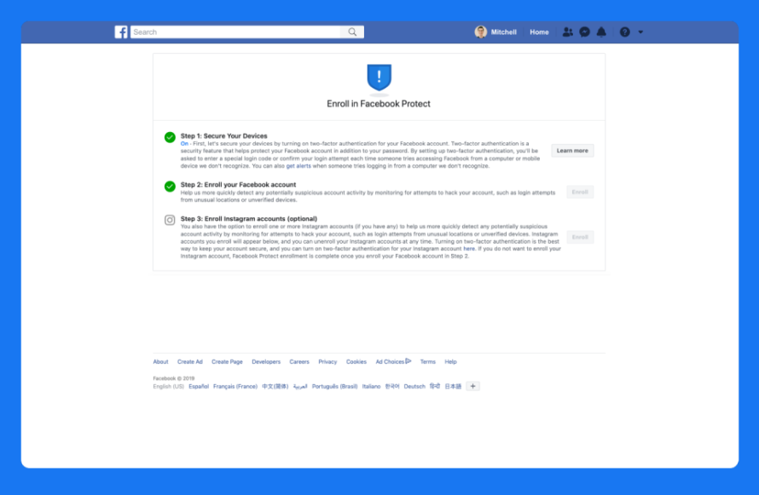

Slide 45
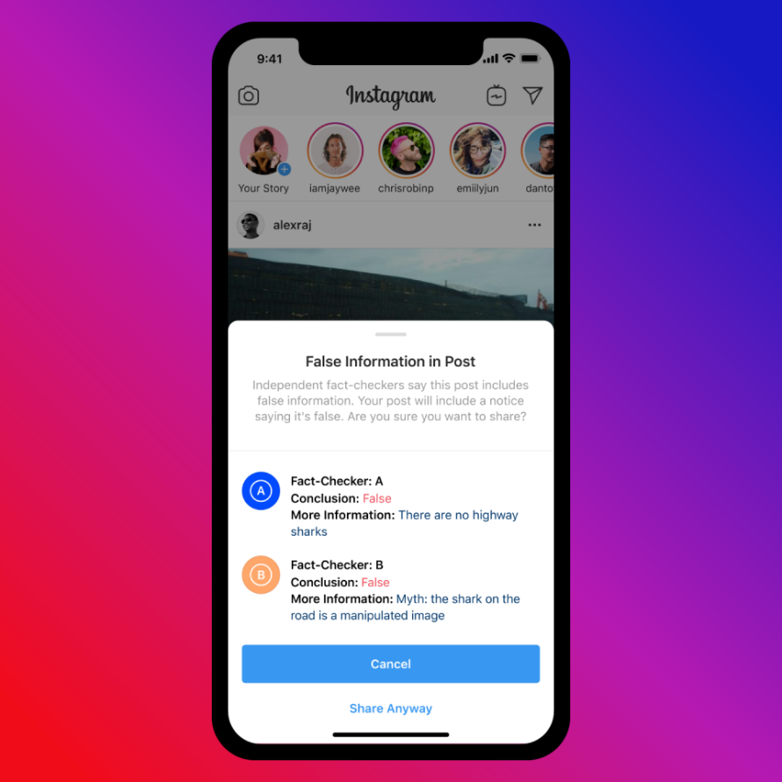

Slide 46
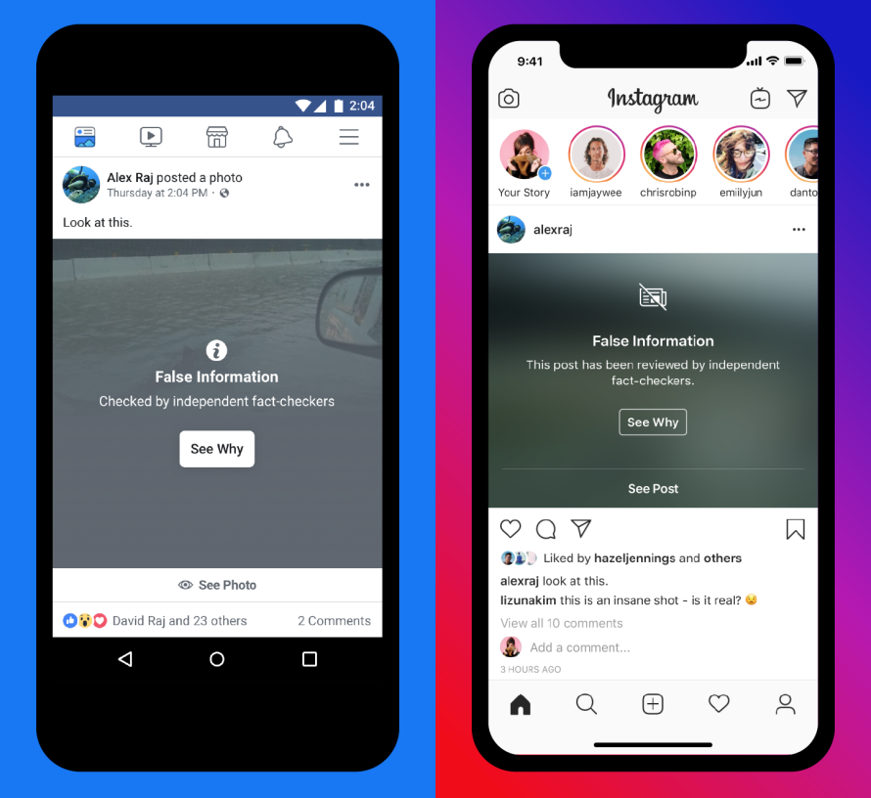

Slide 47
Twitter and US Elections
The 2018 US midterm elections were the most Tweeted-about midterm elections in history. Between the first primaries in March and Election Day, more than 99 million Tweets were sent. The overwhelming majority of these Tweets came from people who expressed their views on issues and candidates. Americans also Tweeted to encourage neighbors, friends, family, and complete strangers to register to vote.
Election Integrity Measures: (1) Updates to the Twitter Rules (2) Detection and Enforcement; and (3) Product Improvements.
During the 2018 US midterms, Twitter took enforcement action on nearly 6,000 Tweets identified as voter suppression attempts; many of these originated in the US.
Compared to 2016, Twitter identified much less platform manipulation originating from bad-faith actors located in countries outside of the US. That said, as part of ongoing investigations, Twitter found limited operations potentially affiliated with Iran, Venezuela, and Russia. Thanks to the increasingly robust nature of Twitter technology and internal mechanisms for spotting platform manipulation, the majority of these accounts were proactively suspended before Election Day.
In early 2019, Twitter strengthened rules against deliberate attempts to mislead voters to now explicitly prohibit manipulating or interfering in the election process. This includes posting or sharing content that may suppress voter turnout or mislead people about when, where, or how to vote.
In early 2020, after gathering more than 6,500 responses from people around the world, Twitter announced the launch of a new rule surrounding synthetic and manipulated media: You may not deceptively share synthetic or manipulated media that are likely to cause harm. In addition, Twitter may label Tweets containing synthetic and manipulated media to help people understand the media’s authenticity and to provide additional context.

Slide 48
Fake Accounts
Twitter may remove fake accounts engaged in a variety of emergent, malicious behaviors. Some of the factors that Twitter will take into account when determining whether an account is fake include 1) Use of stock or stolen avatar photos 2) Use of stolen or copied profile bios and 3) Use of intentionally misleading profile information, including profile location
Attributed activity
Twitter is expanding its enforcement approach to include accounts that deliberately mimic or are intended to replace accounts previously suspended for violating Twitter rules.
Distribution of hacked materials
Twitter is expanding the criteria for when they will take action on accounts which claim responsibility for a hack, which includes threats and public incentives to hack specific people and accounts. Commentary about a hack or hacked materials, such as news articles discussing a hack, are generally not considered a violation of this policy.
Notes:
We are expanding our enforcement approach to include accounts that deliberately mimic or are intended to replace accounts we have previously suspended for violating our rules.

Slide 49
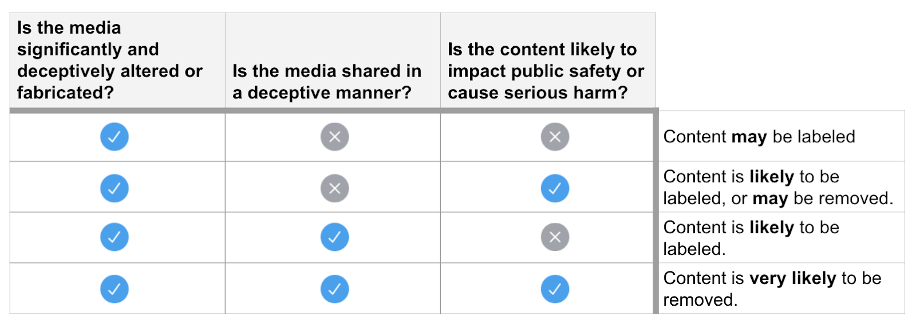

Slide 50
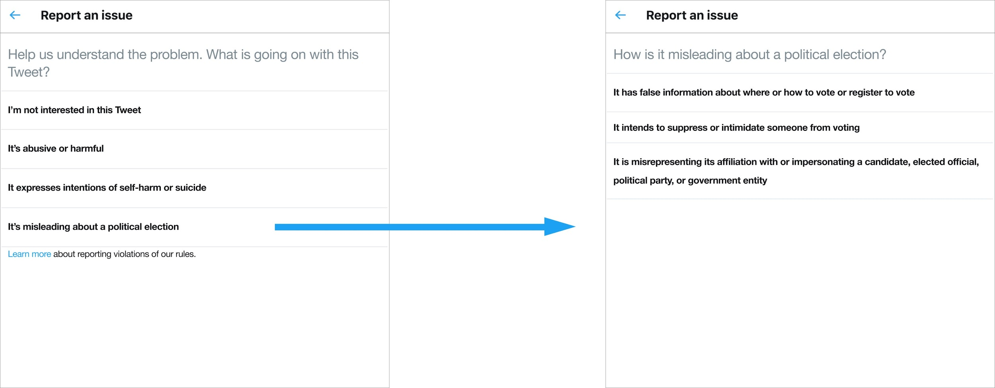

Slide 51
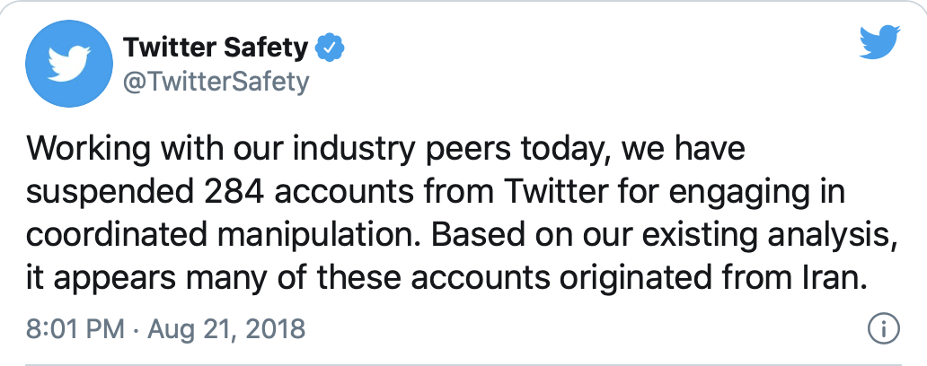

Slide 52
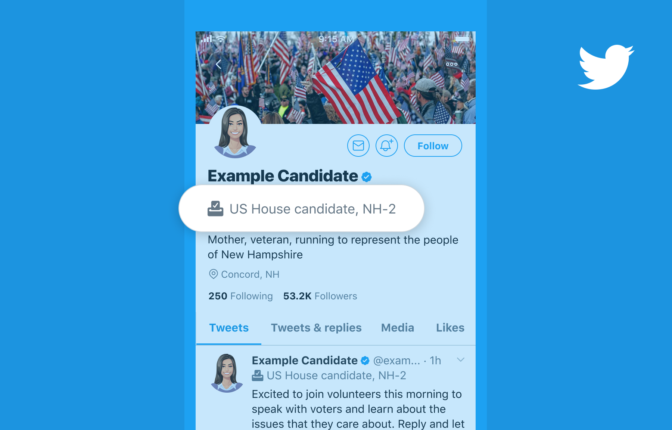

Slide 53
Resources/Experts for Social Media Influence,Law, and Elections[In progress and tentative]
The Center For Social Media And Politics(NYU)
Brennan Center for Justice(NYU School of Law)
International Foundation for Electoral Systems(IFES)

